Slide 2
The CANOPY Project Algorithm-Assisted Resource Allocation Tools for City Planners
Nick Mader
www.github.com/nsmader/canopy

Slide 3
Landscape and Motivation
City planners face:
Mission to serve large, diverse population
Funding scarcity
Limited time for decision-making
Inability to access or mobilize detailed data on population location, needs, patterns of engagement
Multi-dimensional goals
These planners may be:
Public agencies with (large) city-scale programming jurisdiction
Large non-profits with city-wide operations for serving specific populations
Local foundations planning strategic investments in targeted populations

Slide 4
Landscape and Motivation
Example Applications
A city human services agency is tasked with dividing tens of thousands of slots of Head Start funding across the city. They receive applications from hundreds of providers in different neighborhoods, with different styles, histories, and capacities.
A large non-profit currently organizes 10,000+ apprenticeship opportunities to high school-aged youth across the city. They want to know what new program styles and locations can improve engagement of males and Latinx youth.

Slide 5
Landscape and Motivation
Current solutions are:
Dimension/complexity reduction of input considerations (focus on indices, averages, spatial aggregations)
Rules of thumb/judgment calls
Opportunities for stronger solution include:
Less slack in uptake (i.e. unused resources)
Resources better targeted to priority populations
Address donut holes when needy populations are overlooked by being in less needy neighborhoods
Clear perspective on marginal value of additional resources, in terms of where it can go, and who it can benefit

Slide 6
Outline of a Solution
Analysis of Uptake – inference of parameters governing probability of uptake conditional on supply
Articulation of Objectives and Constraints – focus on formal description of dimensions (not necessarily values) of value and constraint
Solution Engineering – optimization methods or simulation specific to the planner’s problem
Unified in dashboard for non-technical users to receive scenario-based recommendations for starting point for human deliberations.

Slide 7
Existing Approaches/Literature
Measuring Accessibility
Davis, Lee & Sojourner (2018) – “family-centered” measure of accessibility of childcare slots, using Census data and two-step floating catchment area
Analyzing Uptake of Human Services
Kline & Walters (2016) – prediction of taking up any Head Start services
Hastings, Kane & Staiger (2006) – discrete choice estimation of parameters governing choice of school
Borden, et al. (2005) – qualitative analysis of uptake of after school programming
Engineering Solutions
Sefair, et al. (2012) – consider accessibility measures (to parks) but not actual utilization
Khayal et al. (2015) – assumes that human needs (emergencies) that arise exogenously
Holguin-Veras et al. (2012) – assume utilization demand (disaster) follows untested deterministic rules
Salema et al. (2007) – product demand is stochastic, but independent of supply
Notes:
“Supply sensitive literature” in health – Dartmouth Atlas literature.
Two-step catchment – some resources you only have in one spot, then you’re not using in other spots.
Measuring potential vs realized access.

Slide 8
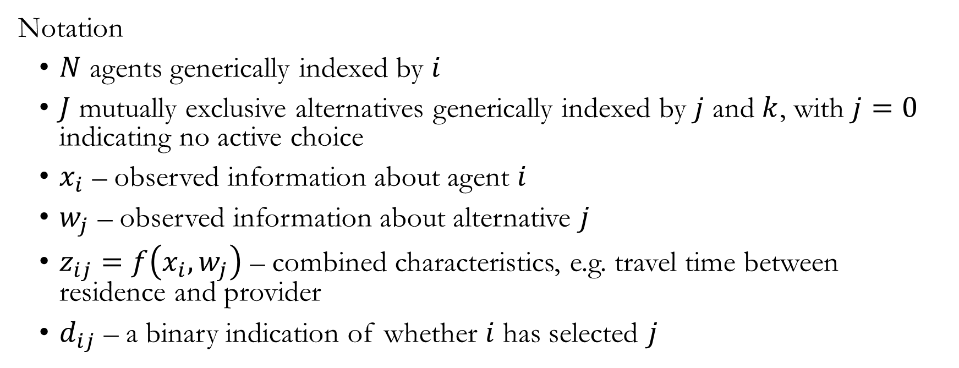
1. Analysis of Uptake
Notation
$N$ agents generically indexed by $i$
$J$ mutually exclusive alternatives generically indexed by $j$ and $k$, with $j=0$ indicating no active choice
$x_{i}$ – observed information about agent $i$
$w_{j}$ – observed information about alternative $j$
$z_{ij}=f\left(x_{i}, w_{j}\right)$ – combined characteristics, e.g. travel time between residence and provider
$d_{ij}$ – a binary indication of whether $i$ has selected $j$

Slide 9
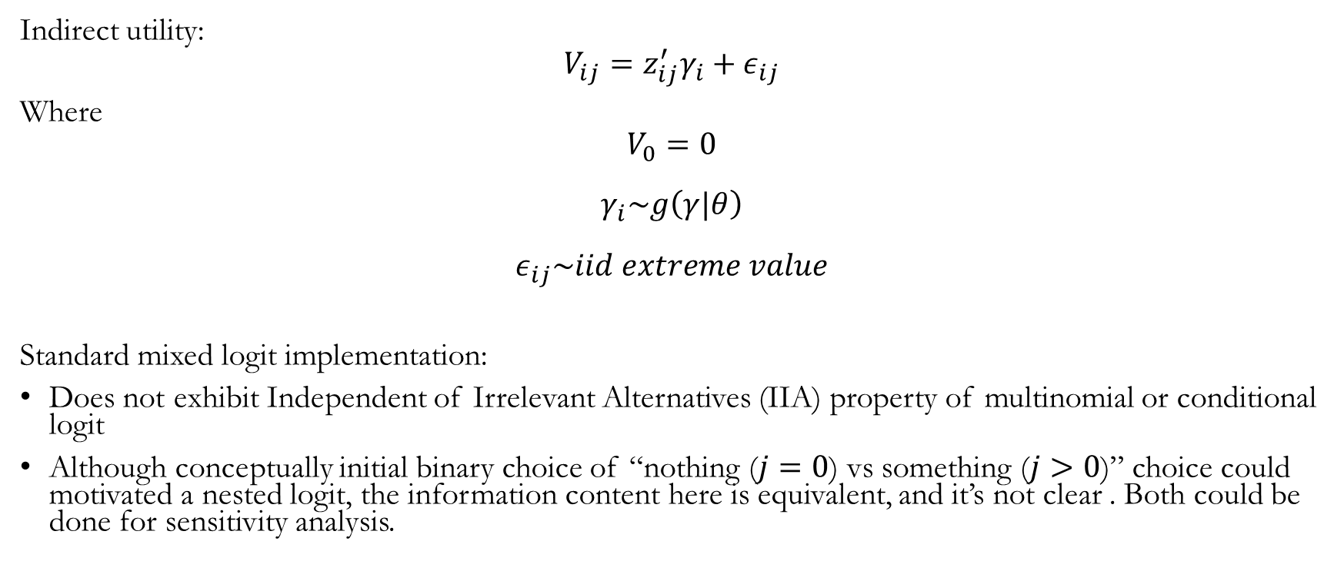
1. Analysis of Uptake
Indirect utility:
$$V_{ij}=z_{ij}^{′}γ_{i}+ε_{ij}$$
Where
$$V_{0}=0$$
$$γ_{i}\sim g\left(γ|θ\right)$$
$$ε_{ij}\sim iid extreme value$$
Standard mixed logit implementation:
Does not exhibit Independent of Irrelevant Alternatives (IIA) property of multinomial or conditional logit
Although conceptually initial binary choice of “nothing ($j=0$) vs something ($j>0$)” choice could motivated a nested logit, the information content here is equivalent, and it’s not clear . Both could be done for sensitivity analysis.
Notes:
Challenges to iid assumption -- Neighborhood and peer effects – consider bringing in neighborhood characteristics. Think through implications of peer effects on out of sample prediction. (Social groups e.g. through theater or athletics, or geography.) (What possibility is there for something like Adhealth, where we find friendship and spatial relationships?)
** Would need to observe marketing. Literature shows the potential impact of word of mouth/trusted source.
** To assess predictive validity – train model on early year of application data, and make a prediction in a later year (with different youth). How much do we miss, and can we identify clusters?
Note: distinction between actual enrollment (which is a negotiation of preferences and lottery) and preference (indicated by application data). Note—complication if there’s strategic listing of preferences.
Could there be dynamics of demand, e.g. evolution of popularity and word of mouth across years, which may correlate with either observed or unobserved dimensions?

Slide 10
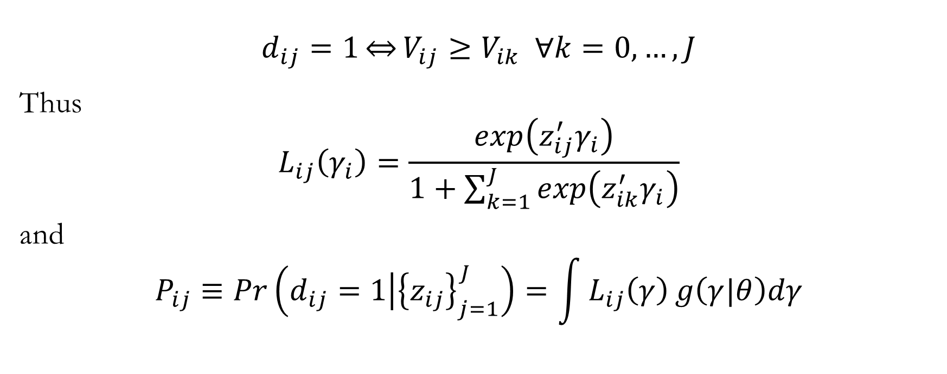
1. Analysis of Uptake
$$d_{ij}=1\overset{⇔}{}V_{ij}≥V_{ik} ∀k=0,…,J$$
Thus
$$L_{ij}\left(γ_{i}\right)=\frac{exp\left(z_{ij}^{′}γ_{i}\right)}{1+\sum_{k=1}^{J}{exp\left(z_{ik}^{′}γ_{i}\right)}}$$
and
$$P_{ij}≡Pr\left(\left.d_{ij}=1\right|{\left\{z_{ij}\right\}}_{j=1}^{J}\right)=\int{L_{ij}\left(γ\right)}g\left(γ|θ\right)dγ$$

Slide 11
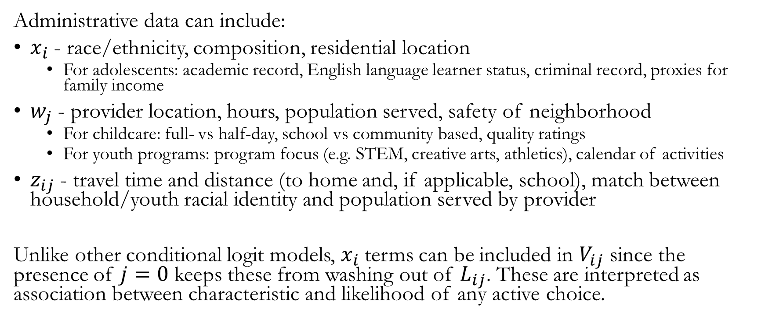
1. Analysis of Uptake
Administrative data can include:
$x_{i}$ - race/ethnicity, composition, residential location
For adolescents: academic record, English language learner status, criminal record, proxies for family income
$w_{j}$ - provider location, hours, population served, safety of neighborhood
For childcare: full- vs half-day, school vs community based, quality ratings
For youth programs: program focus (e.g. STEM, creative arts, athletics), calendar of activities
$z_{ij}$ - travel time and distance (to home and, if applicable, school), match between household/youth racial identity and population served by provider
Unlike other conditional logit models, $x_{i}$ terms can be included in $V_{ij}$ since the presence of $j=0$ keeps these from washing out of $L_{ij}$. These are interpreted as association between characteristic and likelihood of any active choice.
Notes:
Recognize the significance of getting transportation mode right. Consider identifying surveys that have this content. And also: seek qualitative evidence from engaging with populations and policy makers familiar with served populations.

Slide 12
1. Analysis of Uptake
Choice data
Inference from applications rather than enrollment outcomes
Critical, given provider capacity constraints
Early childcare – indication of multiple preferences on application
Youth programming –
Potential for multiple applications at single time
Multiple different periods of enrollment—e.g. apprenticeship terms—over time where different choices can be made

Slide 13
2. Articulation of Objectives + Constraints
Optimization problem
Multi-dimensional
Not formally articulated
Social process is to define concrete dimensions and bounds
Elements of policy space
Allocate resources across existing providers
Allocate capacity as slots
Create new provider locations

Slide 14
2. Articulation of Objectives + Constraints
Elements of objective
Served population is representative of benchmark population (all youth, or priority subpopulation)
Serve highest need individuals
Serve highest need neighborhoods
Service by high quality providers
Elements of constraint
Total resource constraints (slots, programming resources)
Smooth transition from status quo – set transition costs

Slide 15
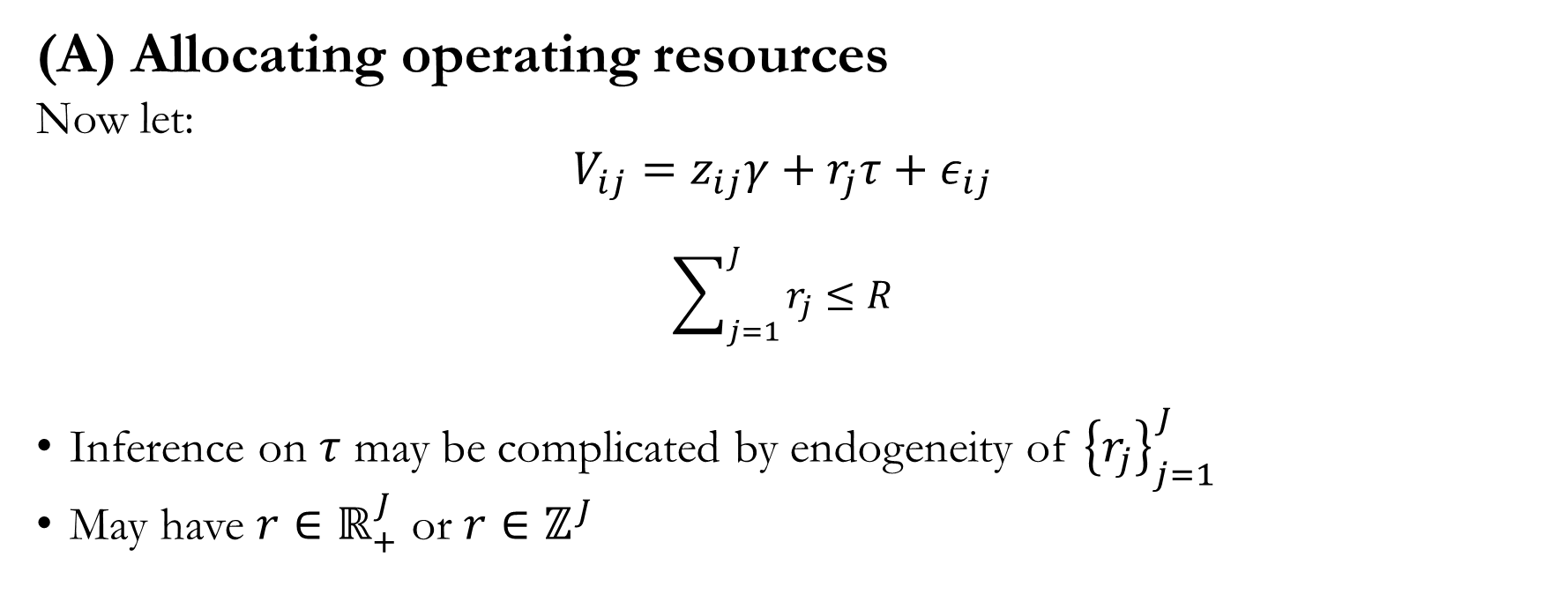
3. Solution Engineering
(A) Allocating operating resources
Now let:
$$V_{ij}=z_{ij}γ+r_{j}τ+ε_{ij}$$
$$\sum_{j=1}^{J}{r_{j}}≤R$$
Inference on $τ$ may be complicated by endogeneity of ${\left\{r_{j}\right\}}_{j=1}^{J}$
May have $r∈ℝ_{+}^{J}$ or $r∈ℤ^{J}$

Slide 16
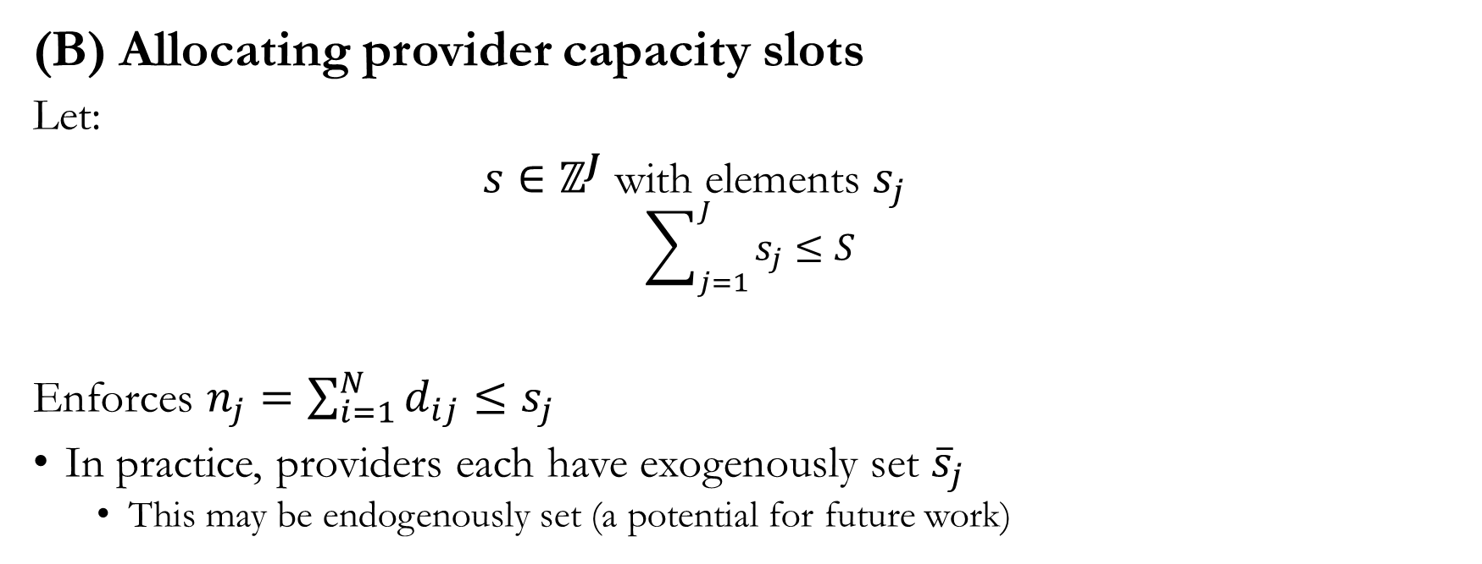
3. Solution Engineering
(B) Allocating provider capacity slots
Let:
$s∈ℤ^{J}$ with elements $s_{j}$
$$\sum_{j=1}^{J}{s_{j}}≤S$$
Enforces $n_{j}=\sum_{i=1}^{N}{d_{ij}≤s_{j}}$
In practice, providers each have exogenously set ${\overline{s}}_{j}$
This may be endogenously set (a potential for future work)

Slide 17
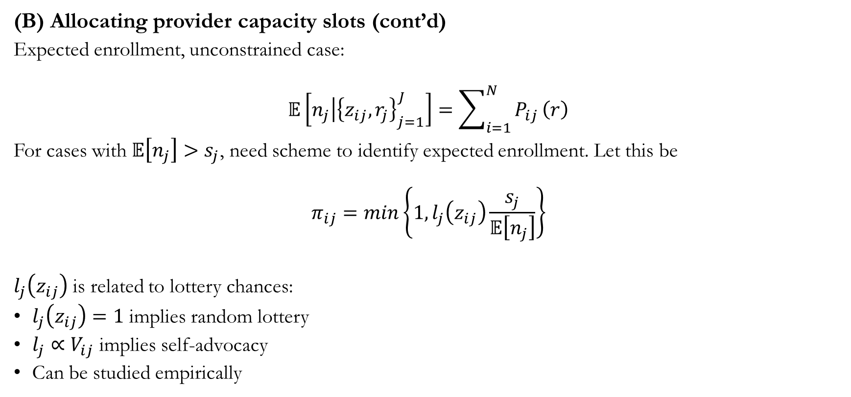
3. Solution Engineering
(B) Allocating provider capacity slots (cont’d)
Expected enrollment, unconstrained case:
$$𝔼\left[\left.n_{j}\right|{\left\{z_{ij}, r_{j}\right\}}_{j=1}^{J}\right]=\sum_{i=1}^{N}{P_{ij}}\left(r\right)$$
For cases with $𝔼\left[n_{j}\right]>s_{j}$, need scheme to identify expected enrollment. Let this be
$$π_{ij}=min\left\{1,l_{j}\left(z_{ij}\right)\frac{s_{j}}{𝔼\left[n_{j}\right]}\right\}$$
$l_{j}\left(z_{ij}\right)$ is related to lottery chances:
$l_{j}\left(z_{ij}\right)=1$ implies random lottery
$l_{j}∝V_{ij}$ implies self-advocacy
Can be studied empirically

Slide 18
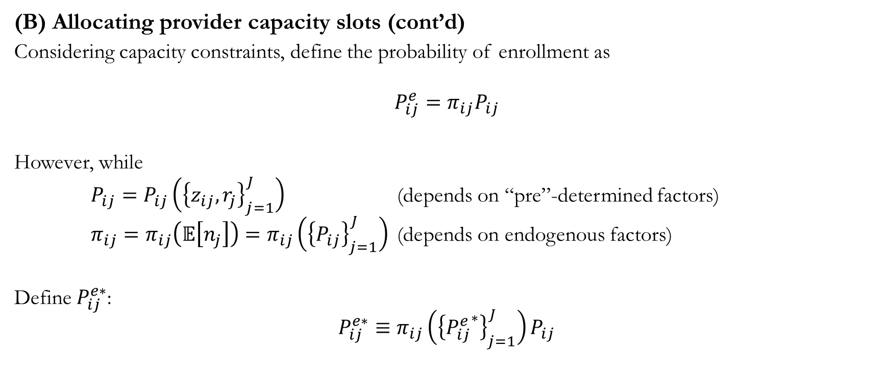
3. Solution Engineering
(B) Allocating provider capacity slots (cont’d)
Considering capacity constraints, define the probability of enrollment as
$$P_{ij}^{e}=π_{ij}P_{ij}$$
However, while
$P_{ij}=P_{ij}\left({\left\{z_{ij}, r_{j}\right\}}_{j=1}^{J}\right)$ (depends on “pre”-determined factors)
$π_{ij}=π_{ij}\left(𝔼\left[n_{j}\right]\right)=π_{ij}\left({\left\{P_{ij}\right\}}_{j=1}^{J}\right)$ (depends on endogenous factors)
Define $P_{ij}^{e∗}$:
$$P_{ij}^{e∗}≡π_{ij}\left({\left\{{P_{ij}^{e}}^{∗}\right\}}_{j=1}^{J}\right)P_{ij}$$

Slide 19
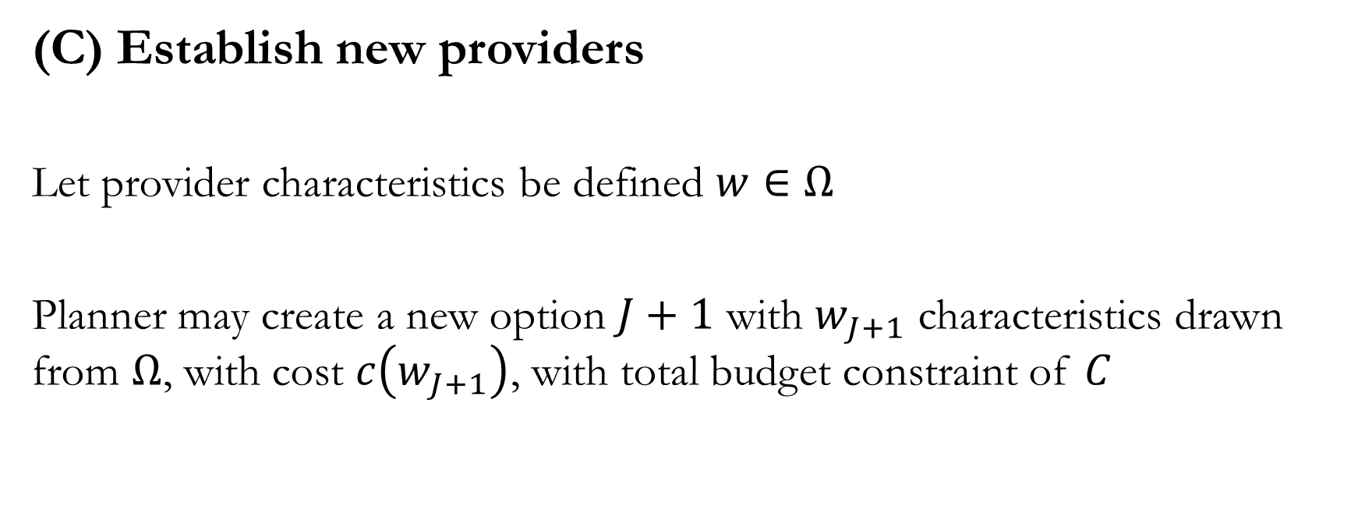
3. Solution Engineering
(C) Establish new providers
Let provider characteristics be defined $w∈Ω$
Planner may create a new option $J+1$ with $w_{J+1}$ characteristics drawn from $Ω$, with cost $c\left(w_{J+1}\right)$, with total budget constraint of $C$

Slide 20
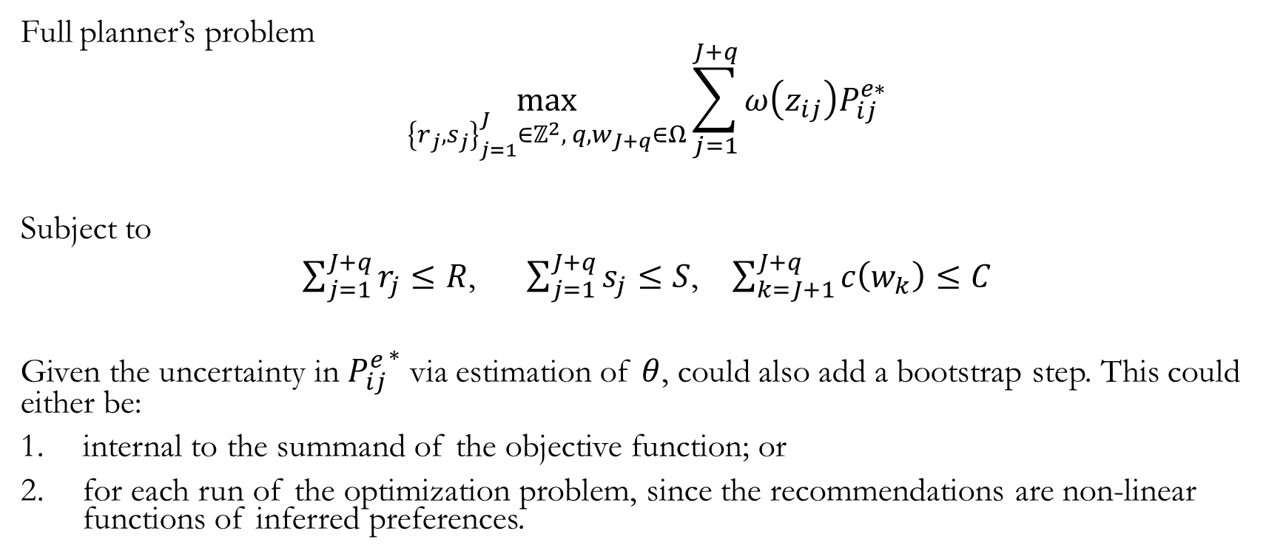
3. Solution Engineering
Full planner’s problem
$$\max_{{\left\{r_{j},s_{j}\right\}}_{j=1}^{J}∈ℤ^{2}, { q, w}_{J+q}∈Ω}{\sum_{j=1}^{J+q}{ω\left(z_{ij}\right)P_{ij}^{e∗}}}$$
Subject to
$\sum_{j=1}^{J+q}{r_{j}}≤R$, $\sum_{j=1}^{J+q}{s_{j}}≤S$, $\sum_{k=J+1}^{J+q}{c\left(w_{k}\right)}≤C$
Given the uncertainty in ${P_{ij}^{e}}^{∗}$ via estimation of $θ$, could also add a bootstrap step. This could either be:
internal to the summand of the objective function; or
for each run of the optimization problem, since the recommendations are non-linear functions of inferred preferences.
Notes:
Geodesign – trucker apps – some folk at ASU, who use “collaboration”. Not pretty as a front-end. Idea is user-engagement process with in-meeting time feedback. See Michael Kuby’s work: https://geoplan.asu.edu/michael-kuby
With respect to uncertainty represented in the model—recognize that locations, or the travel times are not measured with precision (and it’s unclear how to get variance of travel times from Google Distance Matrix). Also, the measured travel time may not be relevant to youth, since they do not take recommended travel paths: measurement error in this variable would create attenuation bias in inference for the coefficient.
On the second approach to bootstrapping (the entire optimization process)--how would one interpret a situation where the estimates are far apart?
# The art of optimization …
One way to simplify the planner’s problem would be discretize the objective function. With continuity, simulated annealing, it checks for improvements but gets subtle feedback. A discrete objective produces larger jumps, giving stronger feedback.
Another approach may be turning the objective into a constraint: e.g. I want to make sure that I want every slot to be utilized. (But not sure how to implement this, since it’s ex ante expectations.)

Slide 21
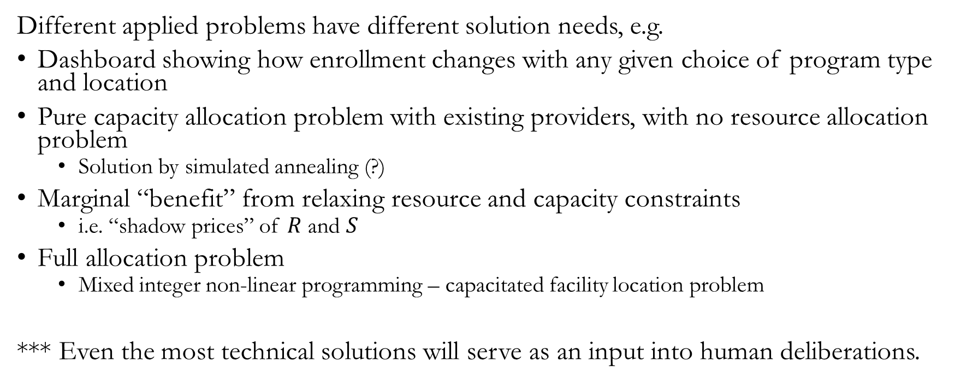
Solution Delivery
Different applied problems have different solution needs, e.g.
Dashboard showing how enrollment changes with any given choice of program type and location
Pure capacity allocation problem with existing providers, with no resource allocation problem
Solution by simulated annealing (?)
Marginal “benefit” from relaxing resource and capacity constraints
i.e. “shadow prices” of $R$ and $S$
Full allocation problem
Mixed integer non-linear programming – capacitated facility location problem
*** Even the most technical solutions will serve as an input into human deliberations.
Notes:
First bullet is Simulation of ${\sum_{i=1}^{N}{{x_{i}P}_{iJ+1}^{e∗}\left(w_{J+1}\right)}}/{𝔼\left[n_{J+1}\right]}$

Slide 22
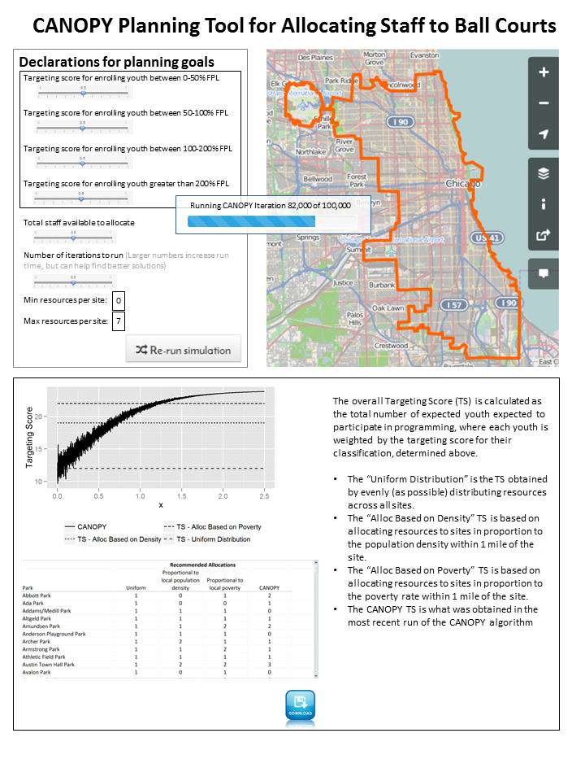
Solution Delivery
Given user backgrounds, form of solution must be:
Non-technical
Scenario-based
Product is:
Dashboard offering visual display of:
Recommended allocation, relative to status quo
Expected populations reached, relative to status quo
Focus on a small handful of scenarios, which is:
Easy to digest/discuss
Feasible to calculate ahead of time (vs all possible policy scenarios)
Ability to download content to get access to individual maps and specifics

Slide 23
Next Steps
Additional project definition, and confirmation of partnership
Permissions
Funding
Test computational feasibility for problems of different complexity
Complete projects focused on low-hanging fruit
Stand-alone analysis of demand side
Simulation of enrollment response to new provider types/locations
Open-sourcing and scaling
Consideration of qualitative complement to ground-truth analysis of demand
nmader@chapinhall.org

